Slide 1
ML in Medical Diagnosis
James Ban
Hiba Kashif
Marcelo Gagliano
Boyang Tang
John Van Pham
Group 8

Slide 2
Overview
Problems with medical diagnosis
Motivations
Restrictions and limitations
Brief history of machine learning in medicine
Systems and tools

Slide 3
Introduction
Problem definition:
Untapped Data due to Privacy Issues
Lack of technical education in Medical staff
Late Diagnosis of diseases
Machine Learning Approaches:
Algorithms for early diagnosis (with Image recognition and Analysis etc)
Cost Cutting
Predict future health of a patient depending on current state of health (Rule mining etc)

Slide 4
Restrictions and limitations
Technical challenges
Assimilate heterogeneous dataset
Only take into account digitized, structured data eg. diagnosis codes, medications
A good diagnosis takes into account many form of data
unstructured data (clinical notes)
visual cues from the patient
Ethical
Privacy
Accountability gap
Susceptible to exploitation.

Slide 5
History
Start in the 1950s with the first generation of commercial computers
3 branches of machine learning algorithms:
symbolic learning
statistical methods
neural networks
Development of advanced methods:
KNN
Bayesian classifiers
Decision trees / rules
ANN, MPNN
Regression model
Ensemble model
Etc..

Slide 6
Early works
Internist-1 / University of Pittsburgh
Rule based Expert system
Design to reproduce the behavior of diagnostician
Uses a hypothetico-deductive approach
Mycin / Stanford University
Expert System
Goal-Directed Reasoning (Backward Chaining)
Diagnose and propose a treatment for blood-borne disease

Slide 7





Cases
Fast Response
Leukemia diagnosis: IBM’s Watson Detected Rare Leukemia In Just 10 Minutes
Patient features:
Exams
Lab results
Medicine taken
Family history
DNA markers
? ? ? ? ?

Slide 8
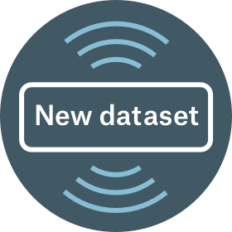
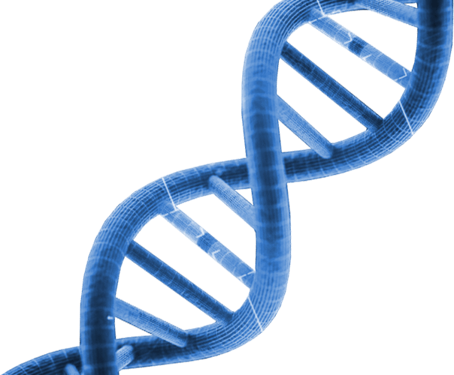

Cases
High Volume
Hamburg-Eppendorf university hospital
DNA analysis to gain a better understanding of the immune system in cancer cases.
1
2
3
10.000.000.000
DNA Sequencing
...

Slide 9
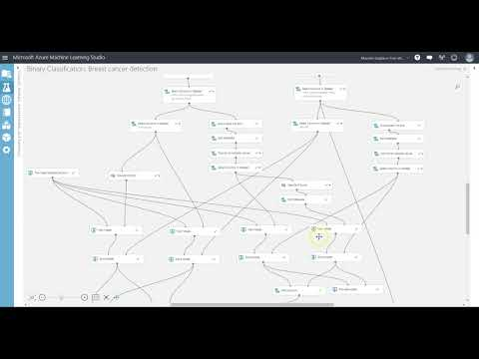
DEMO
Binary Classification: Breast cancer detection
Notes:
The Breast Cancer Info data set contains the label and many ID information for each examination: image-finding-id, study-finding-id, image-id, and patient-id. The Breast Cancer Features data set has 102,294 rows and 118 columns. It contains the features for each patient. There is a one-to-one correspondence relationship between each row of two data sets. In our experiment, we use the label and ID information in Breast Cancer Info data set to split the Breast Cancer Features data set into training and test data sets.

Slide 10
Thank you!
Any question?

